Slide 1

Web Programming 15 Puzzle Group: 4 The Web
Doudou Sy Gueye (Leader, Designer, Programmer, Tester)
Benjamin Pham (Designer, Programmer, Tester)
Hyejin Shin (Designer, Programmer)

Slide 2

User Statement
The user is bored and would like to play a quick game of fifteen puzzle. This is where the web programming fifteen puzzle game comes in. It allows the user to quickly play a game that includes a times which allows for quick pass time for them.

Slide 3
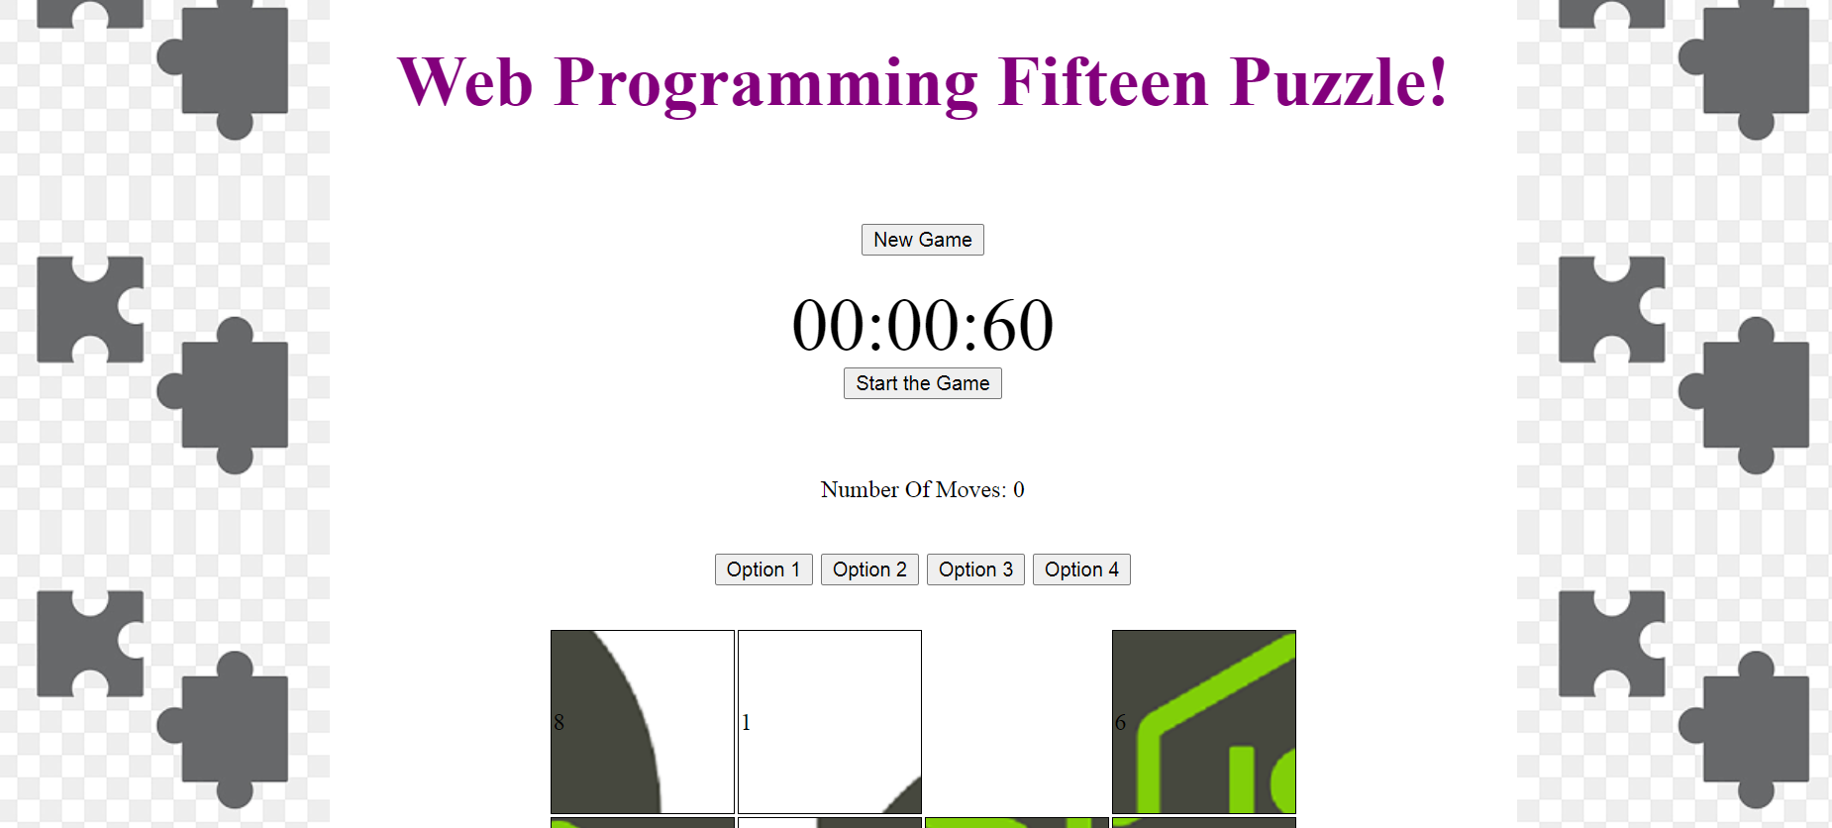
Web Design
The easily designed Web Game was done for the user to quickly start the game as fast as possible
Readability is done precisely for the convenience of the User
Animations Was used in the design of the game
A singular page was used so the user would not have to scroll down

Slide 4
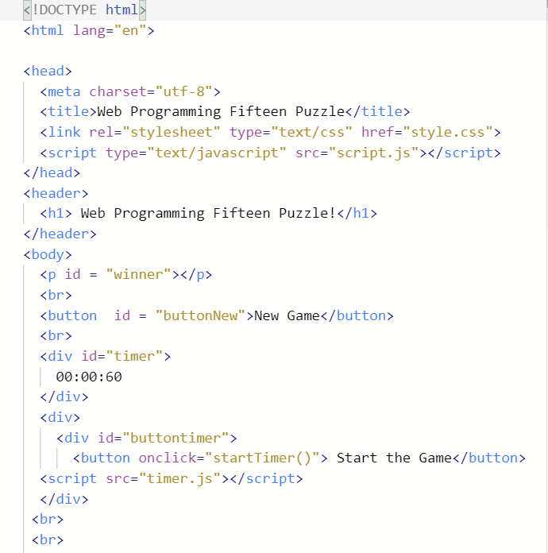
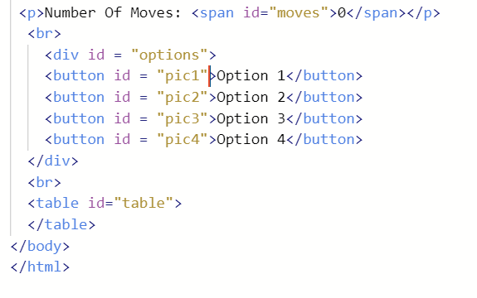
HTML
HTML was used to create the different buttons on the screen to switch the background options, start the timer, and start a new game.
The game board was also designed with a table in HTML.
The timer was also made in HTML along with the number of moves that increment when the user clicks on the tile

Slide 5
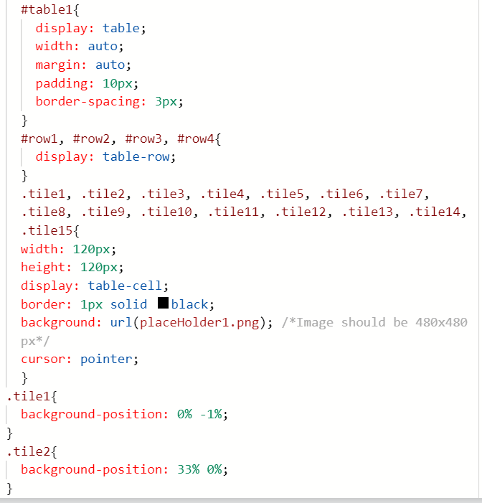
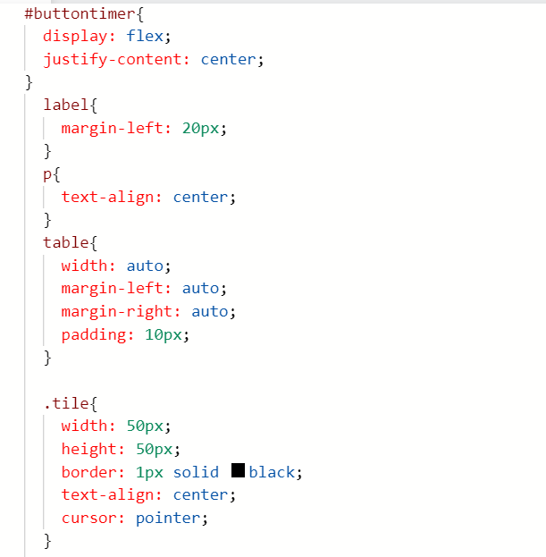
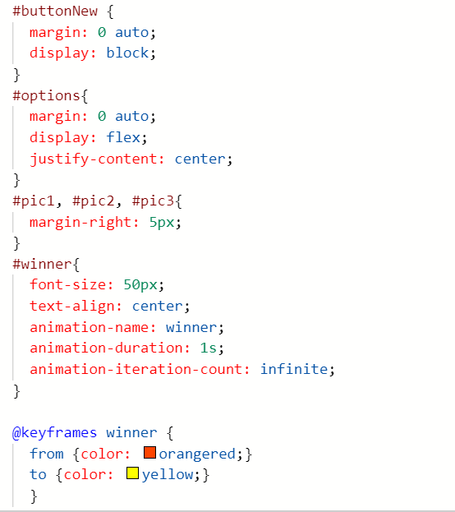
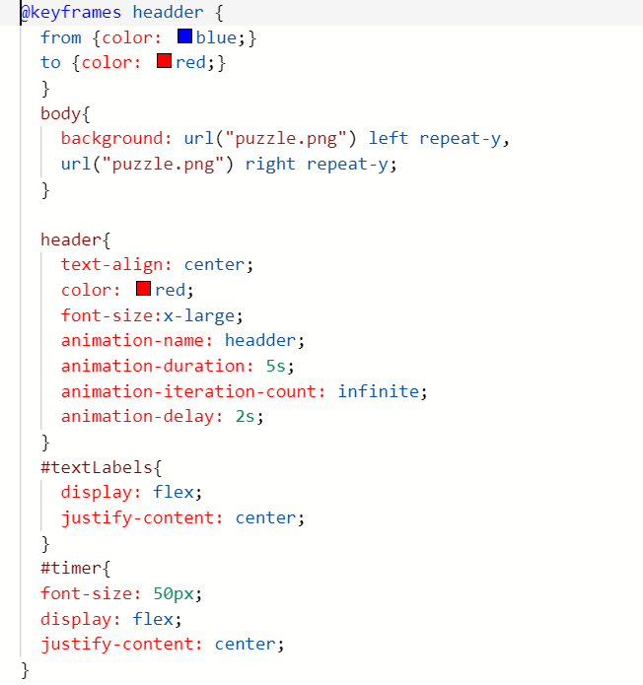
CSS
The CSS was used to create the animation for the title that switches from red to blue and back.
The background puzzle image was made using the puzzle image that repeats on both sides of the image
The timer font size was also changed in CSS along with the alignment of buttons on the screen
The tiles were made using classes in CSS and setting the image in different positions so as the game is completed, the different tiles would form into one image.

Slide 6
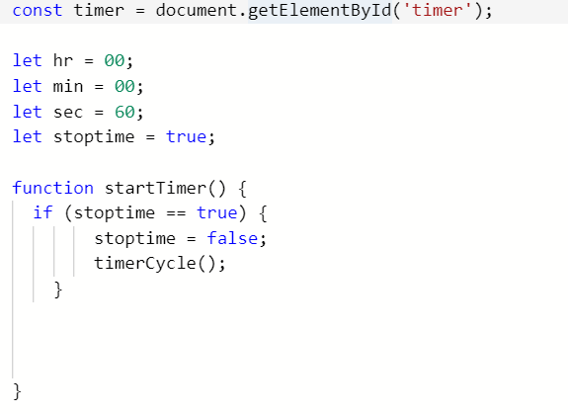
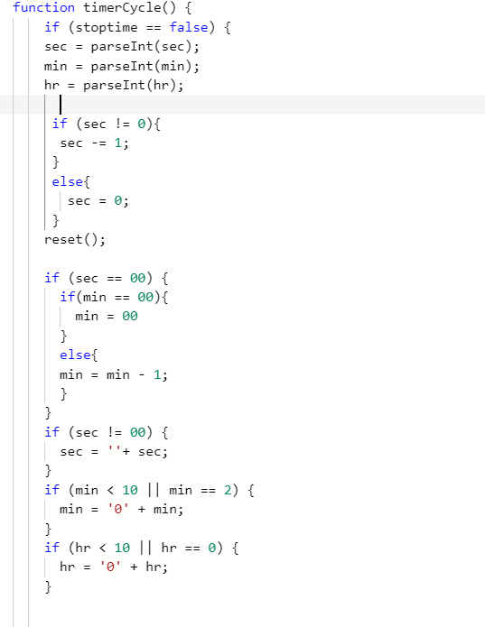
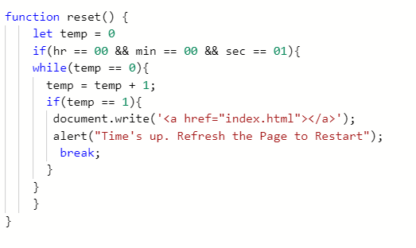
Timer
The timer was done using Javascript and it first starts by setting the hr, min, and the sec to their starting time.
It then creates a variable "stoptime" that is first set to true and then the startTimer function is created and then states that stoptime is false which then calls the function timerCycle
The function timerCycle makes the clock run down from its starting time which is 60 seconds down to 0. The setTimeout was used to set the duration of each second to 2000 so it runs slowly
The function reset was also used so that if the clock hits 0, it makes the page blank and gives the user an alert to refresh the page to start playing again.

Slide 7

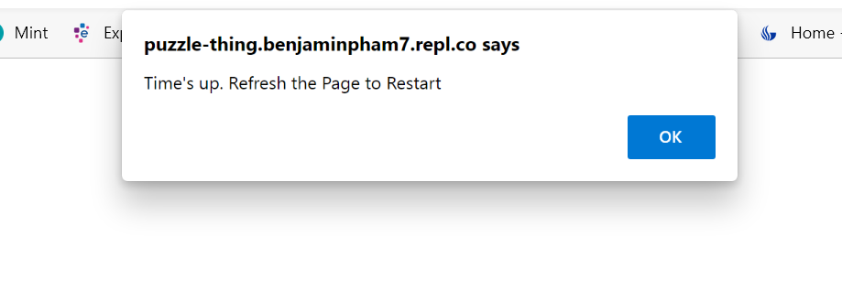
Timer Example

Slide 8
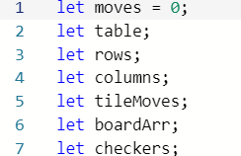
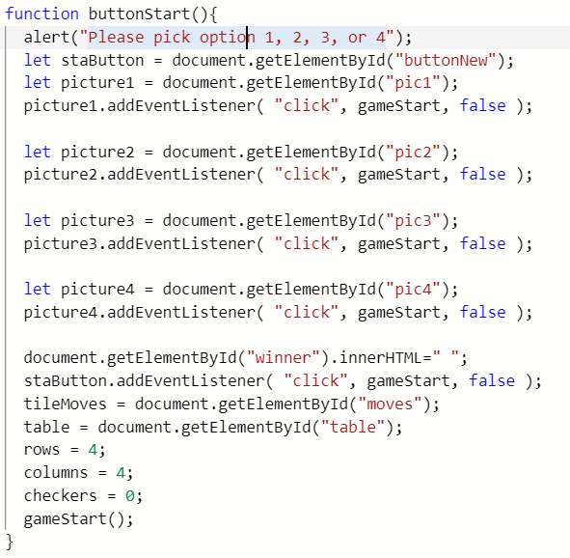
Scripts.js
Variables used – keep track of tiles
ButtonStart function
-> used to start a new game by asking user to click
on an option button and AddEventListener. Calls
gameStart function to randomize tiles

Slide 9
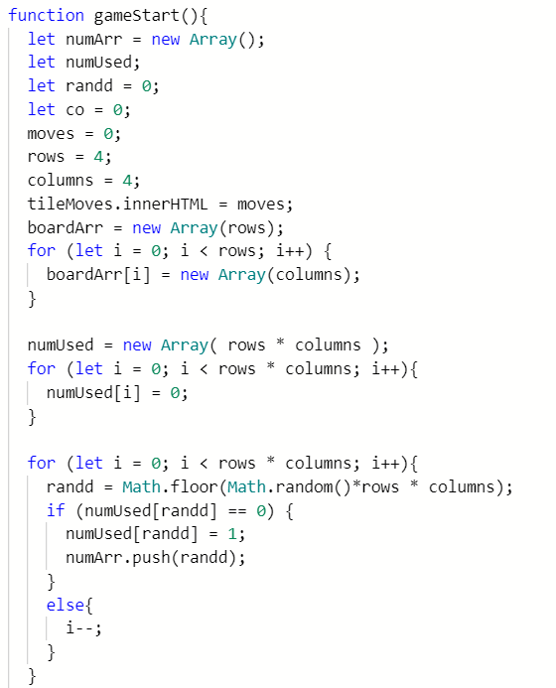
Scripts.js - gameStart()
Start game and creates an array using numArr.
Keeps track of how many moves the user has taken
Shuffles board using for loop and random() function.
This function creates the 4x4 tiles by setting rows and
Columns to 4

Slide 10
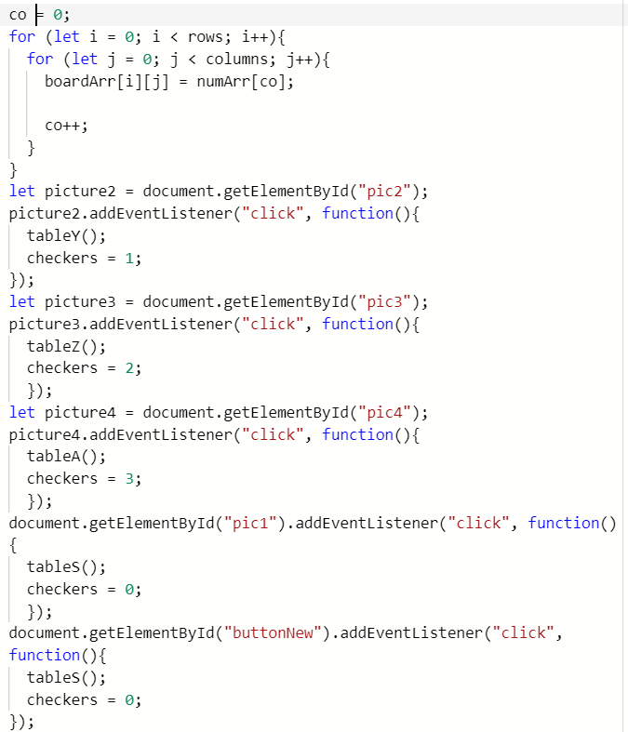
Scripts.js gameStart() cont.
For loop used to traverse the board and assign each
Of the tiles to the index [co].
Picture variables used to hold the button object from the
Html page. If user clicks the button, a table will be created
Using addEventListener and given a checkers value to
Keep track on the specific board
Example: If user clicks option 1 button, tableS
will be the specific Table that holds the puzzle

Slide 11
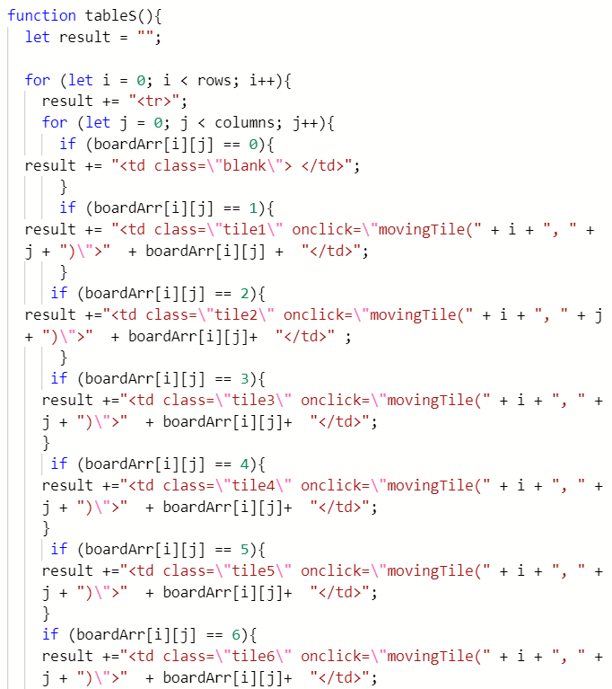
Scripts.js Tables
Tables page used to create the actual table
With different backgrounds. 2D array was used
As the tables page. This method will add these
Lines to the html page to create specific
Puzzles
4 table methods were created to give users
Options on which puzzle image they would
Want to solve

Slide 12
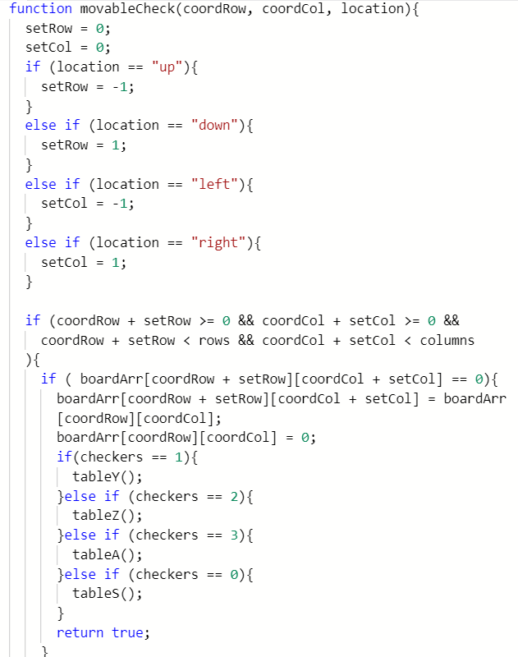

Scripts.js - movableCheck()
Movablecheck function used to check if tile is movable
If the tile is next to an empty space, the clicked tile will move
To that empty spot and the empty spot will fill the old tile
Space.
The clicked tile will check the position and type of puzzle
To move and save its data to its specific table function.
If the function returns false, it means the tile is unmoveable
Since it is adjacent to other tiles and not an empty space

Slide 13
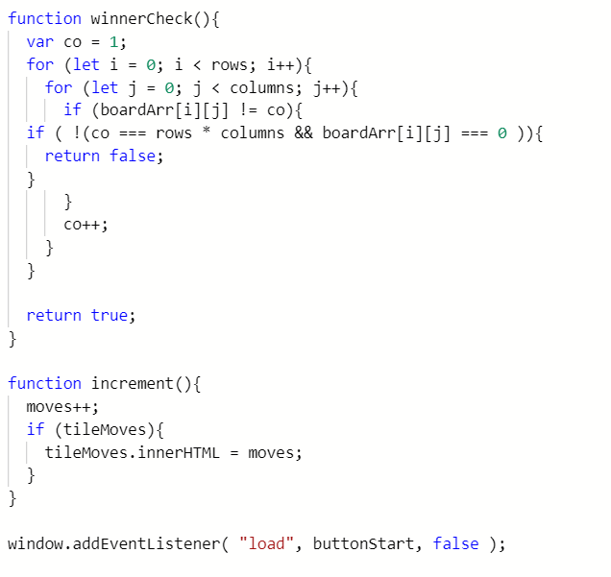
Scripts.js final..
WinnerCheck is used to see if the tiles are
In its correct order. If the board is not in its
Correct order, an if statemate will return it as
False and not finish the puzzle as true.
Increment function used to add up the
User's successful clicks whenever a tile is
Moved.
Window addEventListener will load the button start on page load up

Slide 14
Features of Puzzle
Some specific features of this puzzle include
End-of-Game notification – alerts user of winning and stop the program
Animations and transistions – Texts at the beginning of the program displayed
Multiple background options – The website prompts the user to click on an option button where each button will give the user up to 4 different backgrounds
Extra animations – upon completion of the puzzle, animated texts will be displayed for the user that they have won the game
Game timer – the game has a timer right on top of the page, when the user clicks the "Start game" button, the timer will begin the countdown. When 0 hits, the page will alert the user and refresh the page

